Slide 1

Club Overview
(Get Excited!!!!!)

Slide 2
Agenda
Who is your teacher?
Research Survey
What is Computer Science
Activity
What is Girls Who Code?
What will you do at Girls Who Code

Slide 3
Who is your teacher?
Pradnya Wakchaure
Software Engineer with Vidyo Inc.
Masters in Computer Science
- First program at 13 years old(started at 11)
- Runs, bakes, loves JavaScript and is terrible at making powerpoint slides.
Notes:
Talk about yourself! What do you like / like to do (outside computer science)? What do you like about Computer Science / your job? What was your career path? Feel free to have your own slides with pictures for this.

Slide 4
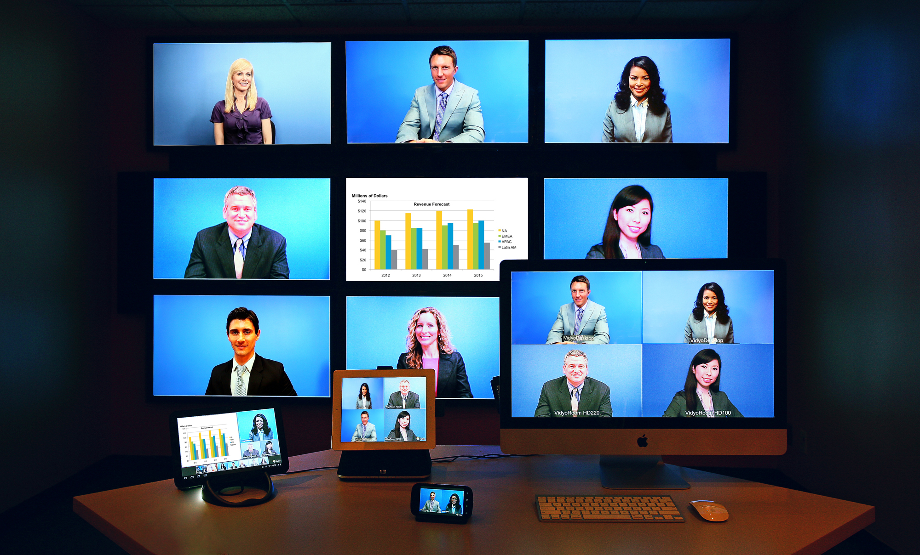
Vidyo

Slide 5
Research Survey!

Slide 6
What is Computer Science?

Slide 7
What is Computer Science?
Solving problems with computers!

Slide 8



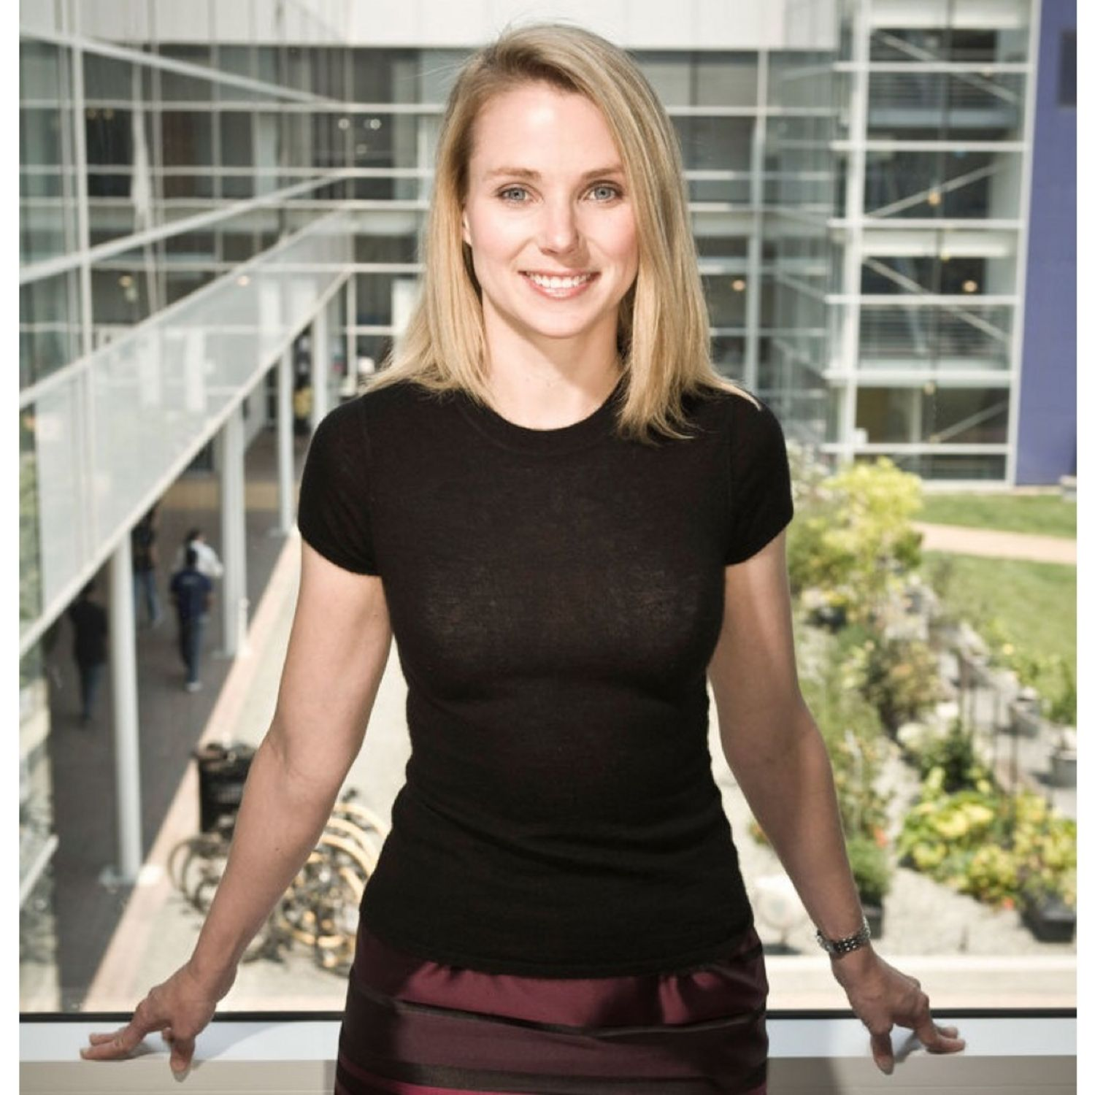
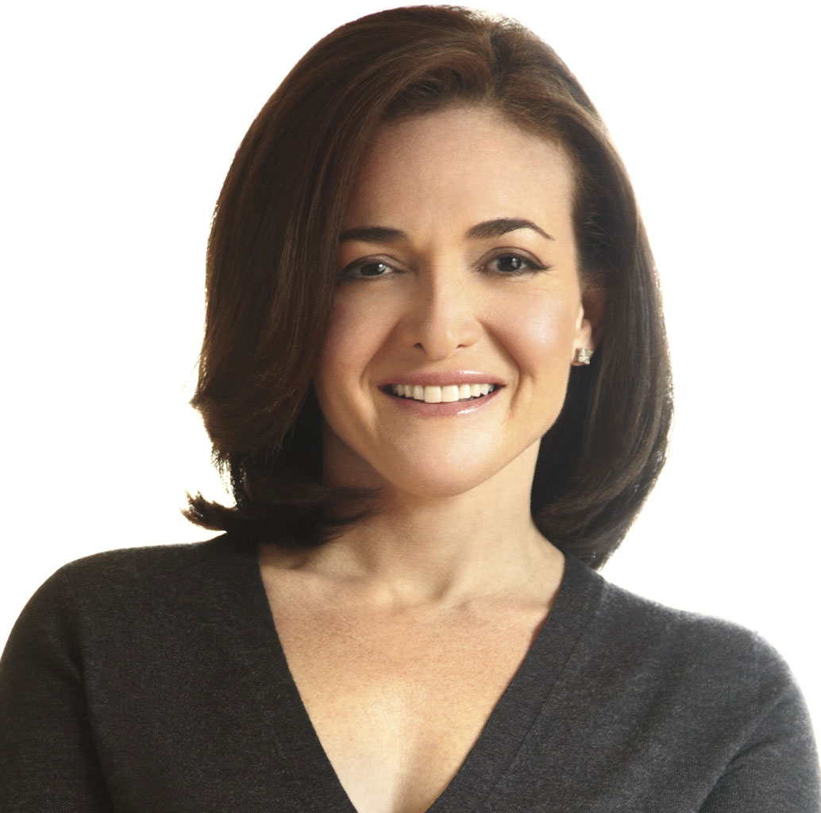
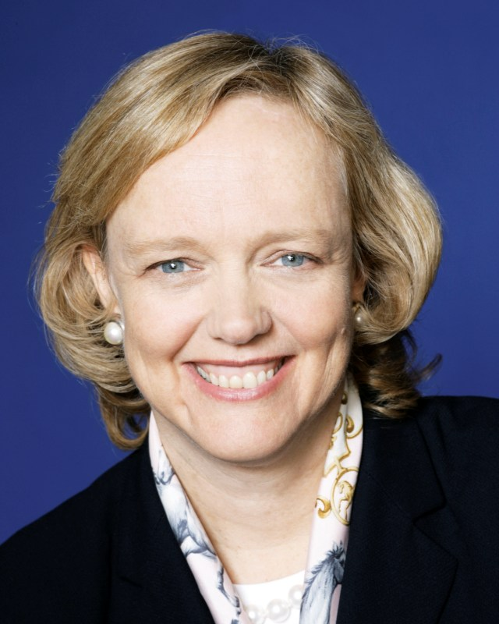
Famous Women in Tech
CEO
COO
CEO
Notes:
Anne Mei Chang (left), is executive director at the Global Development Lab at USAID, which considers how to leverage technology to end poverty. She realized that poverty and hunger correlate with limited access to technology. If we can write and build more efficient systems, we can help the economies of third world countries by giving them access to information and education over the net.
Megan Smith (right) is CTO of the United States. She is working on increasing access to technology for all of the US. She is involved with tech initiatives to bring healthcare and welfare to people.
Kiva helps impoverished entrepreneurs kickstart funding. The founders are Jessica Jackley and Matt Flannery

Slide 9
















What is Computer Science?
Notes:
Almost every company needs to solve /some/ problem with computers. With a computer science degree, you can help social companies, games companies, animation companies!

Slide 10
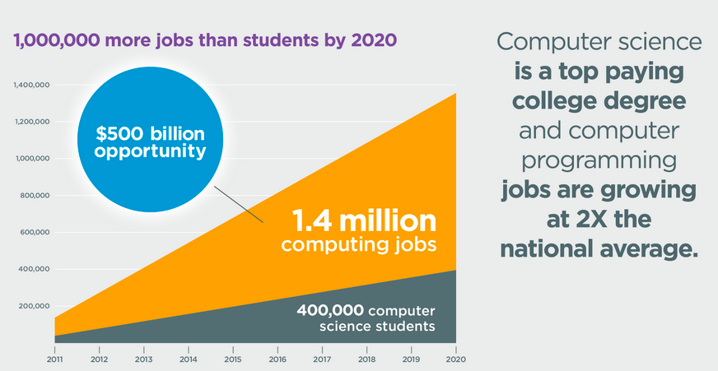
What is Computer Science?
Perks of studying Computer Science
There are lots of job openings (image from code.org)
Notes:
Because of this, the need for computer science majors keeps growing!

Slide 11
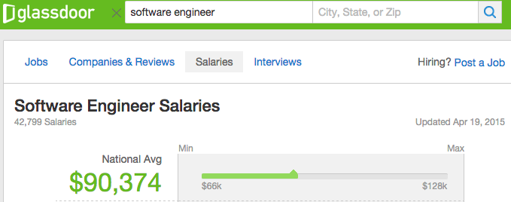
What is Computer Science?
Perks of studying Computer Science
Software Engineers make a lot of money
Notes:
Because of the need for computer science majors, they are frequently paid well

Slide 12
What is Computer Science?
Solving problems with computer science means…
Starting with an idea!
Thinking about the solution through abstraction
How do we translate our idea into concepts used in computer programming?
Developing an algorithm
What are the steps the computer has to take to solve the problem?
Coding!
Implement the algorithm!

Slide 13
What is Computer Science?
Code in Programming Languages!
A programming language is written text that computers can interpret & run.
.
All programming languages:
Run in a given order
Remember things
Can repeat things
And make choices
Any programming language can be learned if you remember these 4 things!

Slide 14
Coding Activity!

Slide 15
Coding Activity
“Program” me to get to a particular place in the room!

Slide 16
Coding Activity
Find the Biggest Number in this list
[2,5,1,6,8,3]

Slide 17
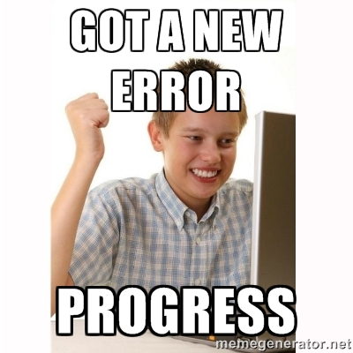
Coding Activity
It is OK to fail and feel frustrated ! That is the only way to learn.
Notes:
This activity serves a few purposes
It lets students be wrong in a fun / funny way. Try to take everything they say in the wrong way. Exaggerate. Make it fun and challenging to be wrong
It encourages students to realize that computers only do EXACTLY what they’re told, and don’t think about it. Don’t let them get away with broad commands like “step.” Have them program your every movement

Slide 18
What is Girls Who Code?

Slide 19
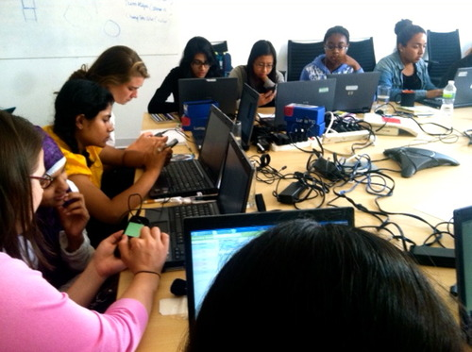
What is Girls Who Code?
Our Mission
Girls Who Code programs work to inspire, educate, and equip girls with the computing skills to pursue 21st century opportunities.
Notes:
We want to fill those jobs -- with awesome women like you!

Slide 20
What is Girls Who Code?
Girls Who Code Welcome Video
Watch the Girls Who Code welcome video here!
Notes:
We want to fill those jobs -- with awesome women like you!

Slide 21
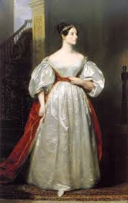
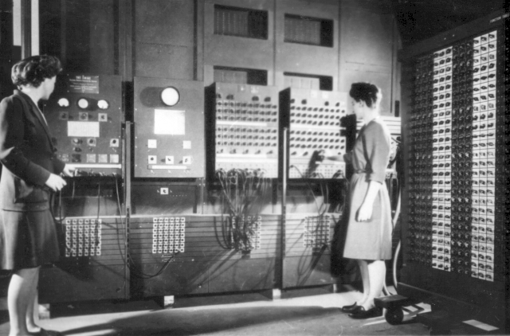
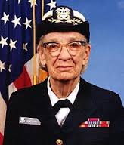
What is Girls Who Code?
The first programmers were women
Ada Lovelace wrote a program for Charles Babbage’s mechanical computer
Kathleen McNulty Mauchly Antonelli, Jean Jennings Bartik, Frances Snyder Holberton, Marlyn Wescoff Meltzer, Frances Bilas Spence and Ruth Lichterman Teitelbaum programmed the ENIAC, the first electronic computer.
Grace Hopper invented the compiler, which allows us to program in English rather than 1s and 0s

Slide 22
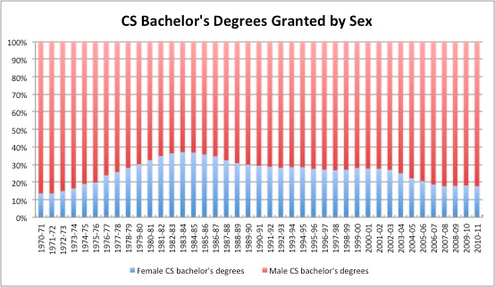
What is Girls Who Code?
Women now make up a smaller percentage...
In 1984, women made up 37% of CS majors, now women are down to 17%
Only 10% of high schools teach CS, but of programmers with CS Majors at Google 95% had studied CS before college.
Notes:
Graph from here: http://www.computerworld.com/article/2474991/it-careers/women-computer-science-grads--the-bump-before-the-decline.html

Slide 23
What is Girls Who Code?
Stereotype Threat
What it is? The threat of being at risk of confirming--as self-characteristic--a negative stereotype about one's group
How can it affect us? Feeling stereotyped can be a huge source of social stress.
Who is stereotyped?
We’re all at risk for being stereotyped!
If you ever feel these things, know you’re not alone!
The fewer people you identify with in a group, the more stereotype threat might affect you
Notes:
http://www.reducingstereotypethreat.org/

Slide 24
What is Girls Who Code?
Impostor Syndrome
Feeling “not good enough” despite evidence of otherwise.
Usually, people with impostor syndrome have higher expectations for themselves than others.
Ways to help get past it
If you feel it, recognize it in yourself!
Talk about your feelings with others
At Girls Who Code, you can find a support network!

Slide 25
What You’ll Do at Girls Who Code

Slide 26
What You’ll Do at Girls Who Code
Build amazing things!
Stories
Art
Web Pages
Mobile apps
Video Games
Get to know awesome people!
Start your journey towards achieving your dreams!

Slide 27





What You’ll Do at Girls Who Code
You will be learning real programming languages used by software engineers!

Slide 28
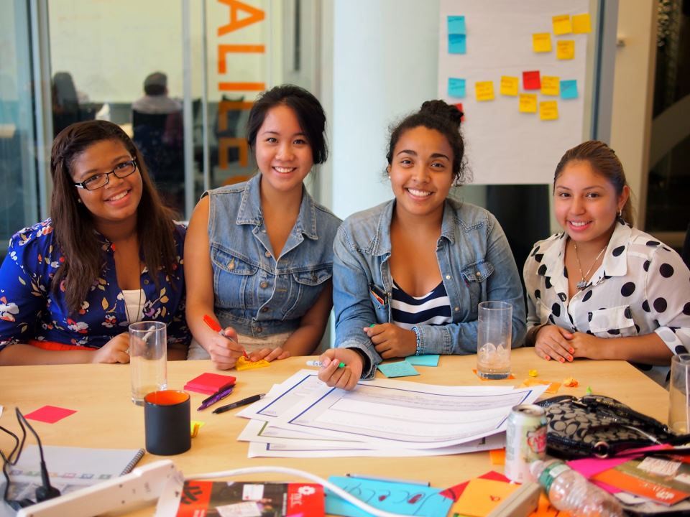
What You’ll Do at Girls Who Code
Most importantly, you will build a family.

Slide 29
What You’ll Do at Girls Who Code
The people @ GWC can help you find jobs or internships &
support you through your academic and professional development.

Slide 30
Media Release / Parental Consent

Slide 31
Media Release / Parental Consent
You will receive a packet that contains the
Media Release and Student Enrollment forms.
Please have your parent(s)/guardian(s) visit the webpage (it is included in the packet!) to fill it out
Ask your family to submit these documents no later than 3 days before our next class
{Wednesday, 21 October 2015 }

Slide 32
Closing

Slide 33
Closing
Learning is hard!
So learning how to program can be hard, too!
Each person:
Share one thing you found hard
Anyone else who found this hard at one point, too, clap
Share how you overcame the hard problem
Notes:
Give students time to think before they start sharing
The point to this exercise is to help students be comfortable with struggling, and help them realize they’re not alone
You can start by giving simple examples, like learning to tie your shoes, or spelling a particular word, or typing. Encourage students by explaining that you found whatever they found hard hard as well.

Slide 34
It’s going to be awesome!!!!!!

Slide 35
Thank you !
Questions ?

